Slide 1


Slide 2


Helping You Navigate Your Benefits
Review information on the Augusta Health HR Website
https://investinginus.augustahealth.com/benefits/
Contact a member of the Augusta Health HR Benefits office at 540-332-4700 or request an appointment for in-person or virtual assistance

Slide 3
Full-Time, Part-Time, and PRN Benefits
Canopy Employee Assistance Program (EAP)
Retirement and How to Enroll/Change 403(b)
Full-Time, Part-Time Benefits
Enrollment Deadline and How to Enroll
Medical Benefits
HSA and FSA
Dental & Vision
Life Insurance, Accidental Death & Dismemberment AD&D
Accident, Critical Illness, and Hospital Indemnity Insurance
Disability Insurance and Time Off
Tuition and Education Assistance
Your Benefits Checklist
Benefit Contacts
PRESENTATION OVERVIEW

Slide 4

Your Total Rewards Designed to meet the needs of you and your family
Preventive care, mental health support, financial security and time for rest.
A supportive culture that fosters a positive team member experience
When you feel your best, you can give your best.

Slide 5

Your Role Matters: Welcome, PRN Team Members
Access to our Team Member Assistance Program (EAP)
Recognition programs that celebrate your impact
Resources/wellness tools on the Team Member Intranet
Eligibility to contribute to the Retirement Plan
Most of the Wellness programs and services
Team Member discounts through Vizient
Tuition.io - Public Service Loan Forgiveness (PSLF)
A culture is built on respect, kindness, belonging, and dignity—for every role and every schedule
Visit the Taking Care of Us Benefits web page for details at https://investinginus.augustahealth.com/taking-care-of-us/

Slide 6


EAP to Support Your Emotional Health
Confidential No-Cost Support When You Need It
8 no-cost free counseling sessions for you and eligible family members Face to face, phone or virtual care options Life resources: Childcare, eldercare, and caregiving support
Legal consultations & mediation Financial coaching Homeownership and housing support Personal coaching: Goal setting, healthy habits, and development Pet parent resources: Insurance, discounts, new pet guidance, and grief support

Slide 7

my.canopywell.com
Enter Augusta Health for company name when registering for the first time
Call: 1-800-433-2320
Text: 503-850-7721
Email: info@canopywell.com

Slide 8

RETIREMENT BENEFITS
  403(b) or Roth – You may contribute 1%-75% of your pay into a pre-tax or post tax account.
  All team members are auto enrolled in pre-tax 403(b) at 1%, will auto escalate each year
  Full-time and part-time team members - Augusta Health matches 50% of the first 6% into the 401(k) Employer Match Plan
  2026 IRS Contribution Maximums:
    403(b) contributions age 49 and under $24,500
    403(b) contributions age 50-59 and 64+ $32,500
    403(b) contributions age 60-63 $35,750
    401(k) Employer match max contribution: $10,800
  View Details: https://www.myfidelitysite.com/AugustaHealth/
  Manage Your Accounts: www.netbenefits.com or by calling Fidelity at 800-343-0860
Full-time, Part-time, and PRN team members are eligible to participate in Augusta Health’s 403(b) retirement plan.
The 403(b) has both Pretax and Roth post-tax options.

Slide 9

Enrollment and Benefit Start Date
UKG Team Member Portal: https://e15.ultipro.com
UKG Job Aide for step-by-step instructions for benefits self-service.
Confirm accuracy of the name, address, socials, and birthdates for your dependents and beneficiaries.
You have 31 days from your start date to enroll in benefits. Be sure to click SUBMIT on or before your 31-day deadline.
Most of your benefits will begin first of the month following your date of hire.

Slide 10
Medical & Pharmacy
Total Well-being Starts with Great Care

Slide 11
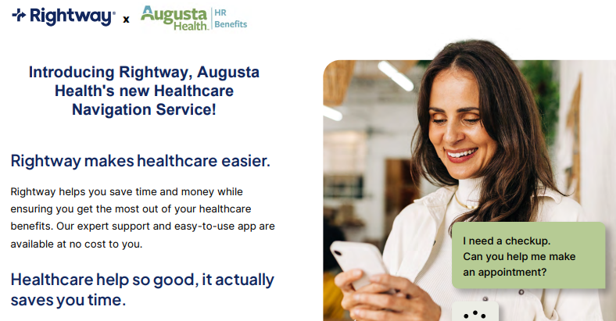

Slide 12

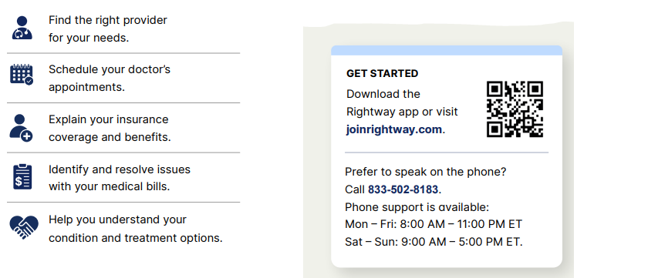

Slide 13

Medical Plan
Care for you and your loved ones, when and where it matters most.
Affordable, high-quality medical plan options
Savings when using Augusta Health providers
No-cost preventive care
Prescription coverage

Slide 14
Medical Plan Options
High-Deductible Health Plan (HDHP) with Health Savings Account
Point of Service (POS)
Higher Deductible
Lower paycheck premium deductions
Augusta Health contributes towards a Health Savings Account (HSA)
2 Networks:
  Augusta Preferred discounted
  Aetna National Network
Lower Deductible
Higher paycheck premium deductions
2 Networks:
    Augusta Preferred discounted
    Aetna National Network

Slide 15
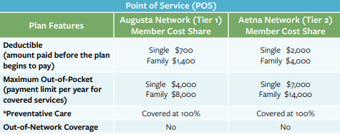
Point of Service (POS) Medical Plan Option
Calendar Year 2026

Slide 16
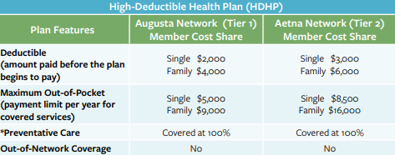
High-Deductible Medical Plan (HDHP) Option
Calendar Year 2026

Slide 17
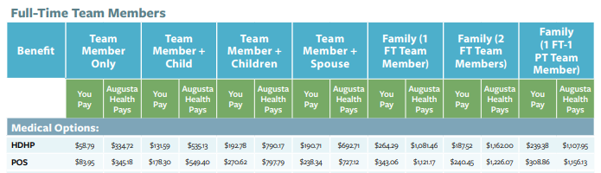
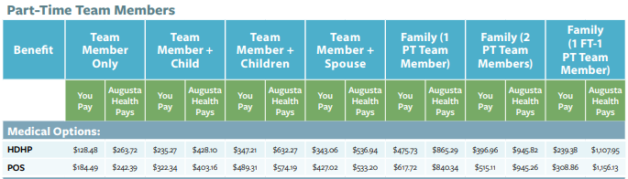
Medical Plan Premiums
2026 Rates deducted from your biweekly paycheck

Slide 18

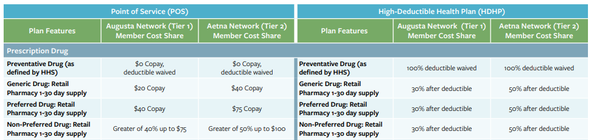
2026 Pharmacy Coverage
    Pay less at the Augusta Health Pharmacy.
    First Floor of Main Hospital; Curbside pick up is available Mon-Fri 7am-9pm
    https://www.augustahealth.com/service/pharmacy/

Slide 19
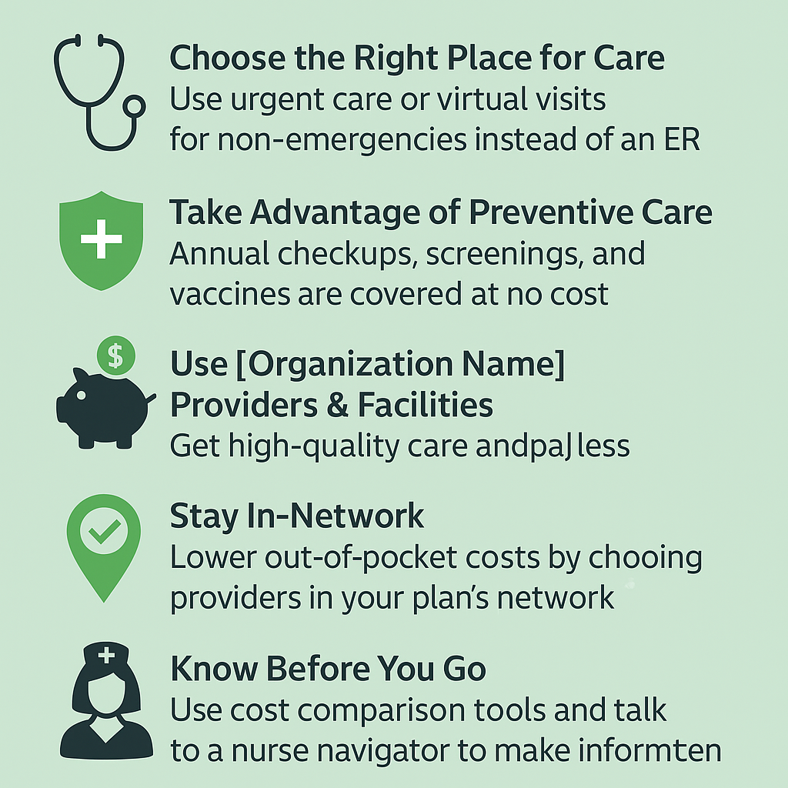

Smart Ways to Save on your Healthcare
Choose the Right Place for Care:
Use urgent care or virtual visits for non-emergencies instead of the Emergency Department
Take Advantage of Preventive Care:
Annual checkups, screenings, and vaccines are covered at no cost when in-network
Use Augusta Health Providers & Facilities:
Get high-quality care and pay less by staying within our Augusta Health network
Know Before You Go:
Use cost comparison tools and talk to a nurse navigator to make informed choices

Slide 20
Health Savings Account (HSA)

Slide 21

Health Savings Account (HSA) Contributions
IRS maximum contribution limits increasing.
Augusta Health contributes a prorated amount based on your benefit start date.
$1,000 Team Member Only
$2,000 for Team Member + Child/Children/Spouse/Family
The combination of you and your employer contributions cannot exceed the IRS limits per calendar year.
INDIVIDUAL CONTRIBUTION
$4,400
FAMILY CONTRIBUTION
$8,750
“Catch-Up” contribution (age 55+)
$1,000

Slide 22
Health Savings Account (HSA)
Take advantage of triple tax savings through the HSA:
Reduce your taxable income by contributing to a Health Savings Account.
Pay for qualified Medical, Dental, and/or Vision expense free of tax.
Earn tax-free interest on HSA dollars and invest tax free.
Confirm your eligibility.
You cannot have a Health Savings Account and:
Be enrolled in Medicare, Medicaid, Tricare, or a non-HDHP plan (if you gain this coverage, you must stop contributions, but you can spend down any money in the account).
Be claimed as another person’s tax dependent.
Have a Full Purpose Medical Flexible Spending Account from another employer or spouse’s employer.

Slide 23
Flexible Spending Accounts (FSA)

Slide 24

Flexible Spending Accounts (FSA)
QUALIFIED FSA EXPENSES
FULL MEDICAL FSA – ELIGIBLE medical, dental and vision expenses
Must be able to track and provide receipts Pre-tax contribution IRS maximum contribution $3,400 ($250 minimum) Full annual election available day one
LIMITED PURPOSE FSA – ONLY FOR dental and vision expenses Must be able to track and provide receipts Pre-tax contribution IRS maximum contribution $3,400 ($250 minimum) Full annual election available day one Dependent Care (FSA) – TAX DEPENDENTS FOR ELIGIBLE CHILDCARE OR ADULT CARE
Must be able to track and provide receipts Pre-tax contribution IRS maximum contribution $7,500 ($250 minimum) Available as deposited
Eligibility
Full Medical FSA Open to all FT/PT team members except those contributing to an HSA Limited Purpose FSA Open to only team members contributing to an HSA
Dependent Care FSA Open to all FT/PT team members

Slide 25
DENTAL

Slide 26

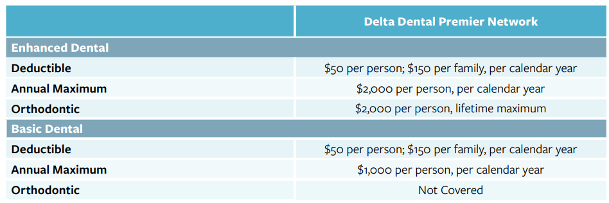
Your Dental Coverage Choices
Delta Dental Premier

Slide 27
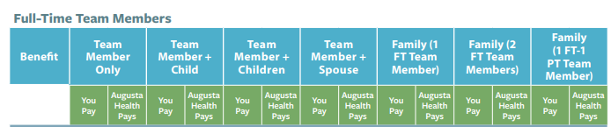



2026 Dental Plan Rates

Slide 28
Vision

Slide 29

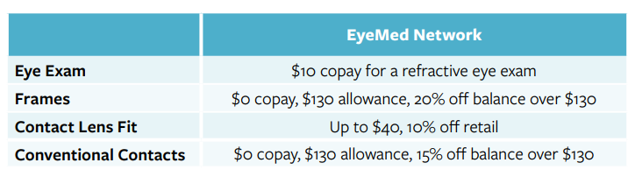

Vision & Hearing Coverage
Hearing aids are covered under the Augusta Health Medical Plan (when medically necessary).

Slide 30


2026 Vision Plan Rates

Slide 31
Life Insurance and
AD&D Insurance

Slide 32
Employer Paid Life Insurance and Employer Paid Accidental Death and Dismemberment (AD&D)
Augusta Health provides eligible team members (full-time or part-time) life insurance and accidental death and dismemberment (AD&D) insurance at no cost.
Automatically enrolled at hire
  1x your annual salary for life coverage
  2x your annual salary for accidental death and dismemberment (AD&D)
  Annual salary maximums may apply – view schedule for details
  Please be sure to update your beneficiary information!

Slide 33

Supplemental Life and AD&D Insurance –
for Yourself, Spouse, and Child(ren)
Yourself
Elect up to $500,000
Your elected amount over $250,000 will require evidence of good health
Spouse
Elect from $5,000 up to $500,000 (spouse not to exceed your total amount)
Spouse guarantee issue is $25,000 and amounts over require medical evidence
Spouse not eligible if also covered as a team member under this policy
Child(ren)
Elect to cover all eligible dependent child(ren)
Provides coverage $10,000 per child through age 26
View Supplemental Employee, Spouse, and Child Life Insurance and Supplemental Employee, Spouse, and Child AD&D Insurance schedules for more details.

Slide 34
ACCIDENT, CRITICAL ILLNESS, AND HOSPITAL INSURANCE

Slide 35

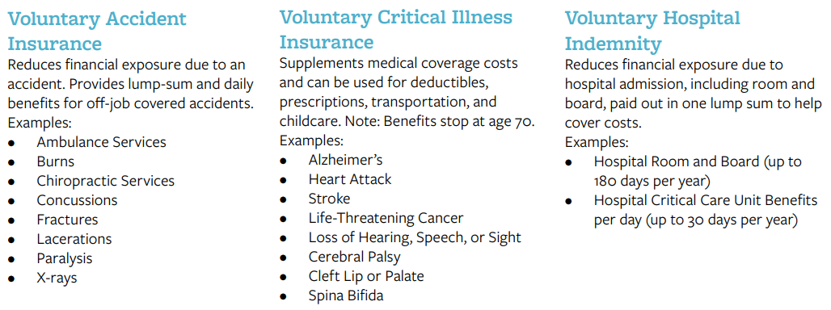
Voluntary Accident, Critical Illness, and Hospital Indemnity
Options helping you and your family plan for the unexpected. Rates and age limitations apply. View the full schedules of benefits for more details.

Slide 36
DISABILITY AND
TIME OFF BENEFITS

Slide 37

Employer Paid Short-Term Disability (STD)
Augusta Health provides eligible team members (full-time or part-time) short-term disability (STD) at no cost. This benefit provides income replacement when you are unable to work due to a covered illness, accidental injury, or condition including, sickness, mental illness, substance abuse or pregnancy.
Automatically enrolled at hire
  Provides 60% salary replacement for the duration of your claim
  Enrollment is automatic, and there is no cost to you
  View the STD schedule of coverage for details on how this coverage works

Slide 38

Employer Paid Long-Term Disability (LTD)
Augusta Health benefits also include long-term disability (LTD) insurance providing income replacement for eligible team members who are unable to work for an extended period due to a covered illness, injury, or medical condition.
Automatically enrolled at hire
  Payments cover 60% of pre-disability salary, up to a monthly maximum
  There is no cost to you for this benefit
  Follows short-term disability (STD)
  View the LTD schedule of coverage for details on how this coverage works

Slide 39

Paid Time Off (PTO)
Full Time Team Members will begin accruing 7.692 hours each pay period (25 days per year) and increase by 3 days with every 5 years of service.
Part Time Team Members will accrue 50% of FT accrual based on number of hours worked.
Covers vacation, holidays, illness, and time off for conducting personal business.
Max year-end carryforward for full-time is 350 hrs.
PTO balance eligible for cash out (see policy for details).
IMPORTANT NOTE: Time off and leave policies vary based on one’s position type and hours worked (FT/PT/PRN/Physician, etc.) Please visit Policy Manager for more information specific to your position at Augusta Health. Other types of absence policies (example bereavement and FMLA) also available on Policy Manager.

Slide 40
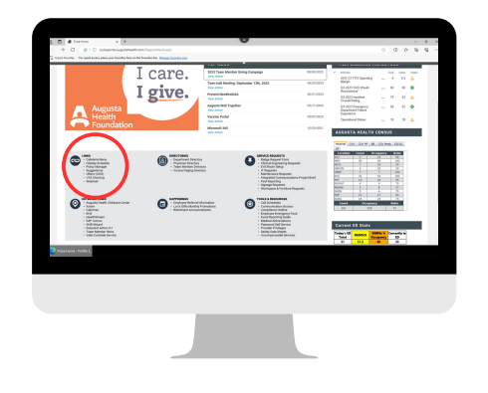
View Time Off and Leave Policies…
Easy as 1, 2, 3!
Click on Pulse (Augusta Health Intranet) located on your work computer.
Scroll down to the “links” box at the bottom and click Policy Manager.
At the Policy Manager log-in screen you will sign in with your network credentials. Under the Policies & Procedures search box type in, “Time Off” or “Leave” and consult your direct supervisor when submitting a time off request.

Slide 41
EDUCATION ASSISTANCE

Slide 42

Education Assistance
Tuition.io Loan Assistance (PSLA, SLRA) - Contact Tuition.io (support@tuition.io) for more information about PLSF and SLRA.
Public Service Loan Forgiveness (PSLF) is a federal program that forgives (tax-free) any remaining student loan balance for those who work full-time at a qualified not-for-profit and make 120 qualifying payments. Augusta Health qualifies as an eligible employer for the PSLF Program. Tuition.io guides team members through the complex process of determining PSLF eligibility and filing an application. All team members with student loans should apply for PSLF to determine if they qualify.
Student Loan Repayment Assistance (SLRA) is available to team members in certain nursing and respiratory therapy positions. Team members who qualify for this program will receive $350/month towards their eligible non-taxable student loan payment up to $5,250/year (or taxable loan payment if above the $5,250 up to the lifetime maximum of $10,000) across ALL educational benefits.
Tuition Reimbursement is available to support the professional and career growth goals of our team members, Augusta Health offers a Tuition Reimbursement Program for job-related education. This education could pertain to current roles or opportunities for promotion or transfers, including development for specific skills, preparing, or maintaining licensure or certification, or earning a degree.

Slide 43
NEXT STEPS
& RESOURCES

Slide 44

Your benefit enrollment Checklist
Review the benefit resources and ask questions.
Enroll in your benefits within 31 days and confirm accuracy of you and your dependent(s) information.
When enrolling in benefits, print or save a copy of your Benefits Statement and be sure to click SUBMIT.
Review your new benefit information as it arrives by e-mail or US mail, and review pay slips to confirm accuracy.

Slide 45
Questions?
Notes:
Happy Enrolling

Slide 46

Thank You!

