Slide 1
Fostering a Culture of Ownership
Augusta Health
February 28, 2025
Presented by Joe Tye

Slide 4
“Joy in work – or the lack there of – not
only impacts individual staff engagement and satisfaction, but also patient experience, quality of care, patient safety, and organizational performance.”
Perlo J, Balik B, Swensen S, Kabcenell A, Landsman J, Feeley D. IHI Framework for Improving Joy in Work. IHI White Paper. Cambridge, Massachusetts: Institute for Healthcare Improvement; 2017.

Slide 6
“The best leaders create a
culture that develops people to
live fully, wholeheartedly, and
have fun along the way.”
Jim Murphy: Inner Excellence

Slide 7
It takes courage to
model joy when the
times are tough.

Slide 8
It takes courage to
model joy that you
might not feel yourself.

Slide 9
It takes courage to
model joy as you head
into the storm.

Slide 15
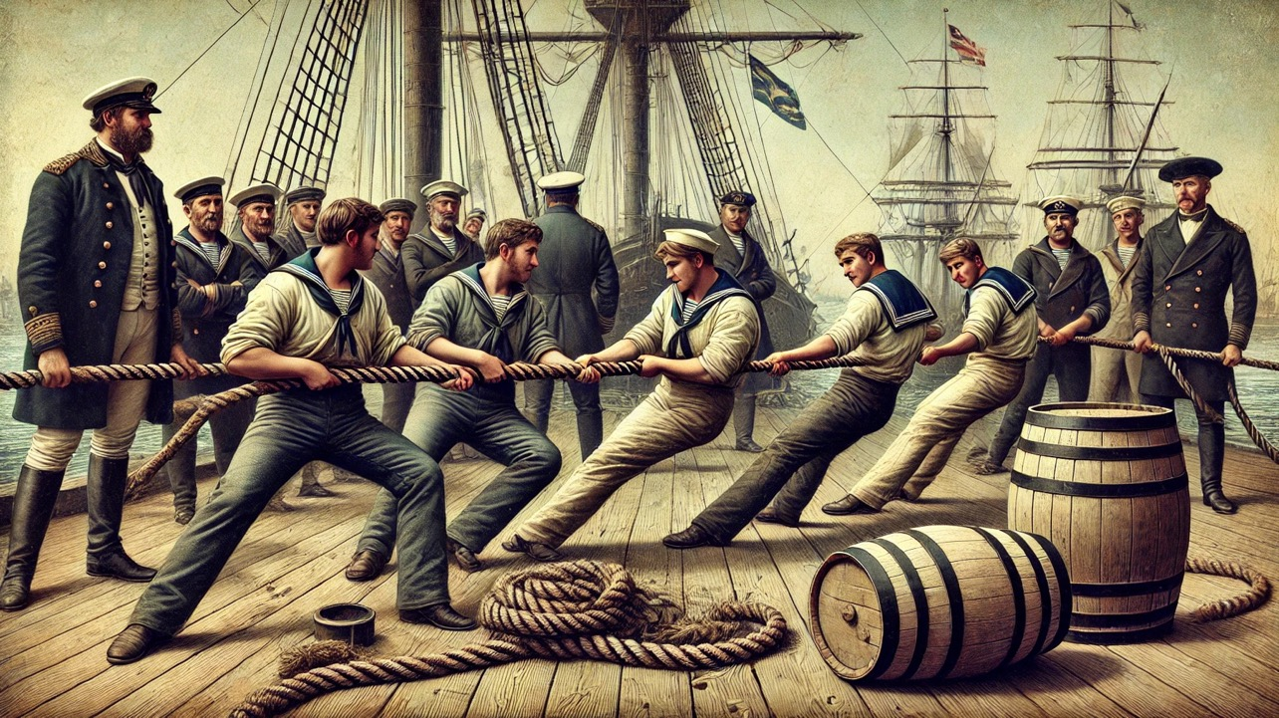

Slide 17
Why this matters

Slide 18
Workers who strongly believe their organization cares about their wellbeing are >>>

Slide 19
69%
Less likely to actively search for a new job

Slide 20
5X
More likely to strongly advocate for their company as a place to work

Slide 21
71%
Less likely to report experiencing a lot of burnout

Slide 22
BUT...

Slide 23
“The percentage of employees who strongly agree their organization cares about their overall wellbeing tied a record low of 21% in early 2024.”
Gallup: Despite Employer Prioritization, Employee Wellbeing Falters, November 2024

Slide 25
What is going to influence my willingness to recommend?

Slide 26
Think of the investment that goes into the design and construction of a new hospital...

Slide 31
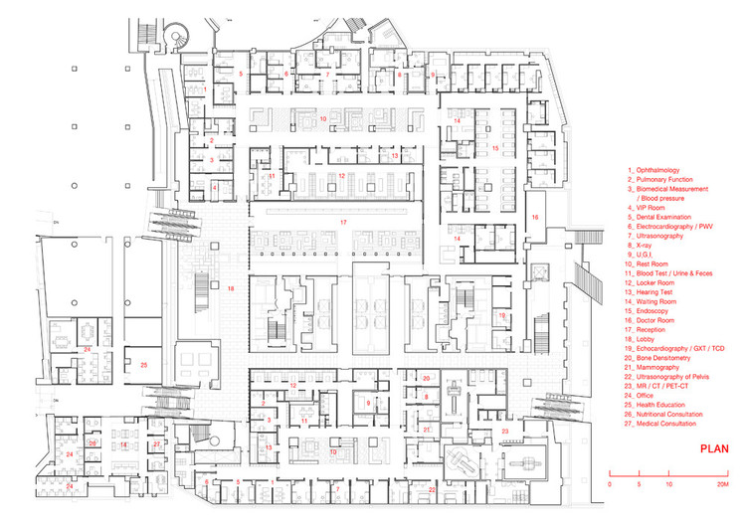

Slide 36
But then...

Slide 38
Invisible Architecture is to
the soul of your organization what physical architecture
is its body.

Slide 39
It has a greater impact on employee and patient experience than the physical bricks and mortar.

Slide 40
The Blueprint Behind the Blueprint

Slide 41
Accountability
Doing what you are told to do because
there are consequences. Accountability
is imposed by the extrinsic motivation of reward and (mostly) punishment.

Slide 42
Ownership
Doing what needs to be done because you expect it of yourself. Ownership springs from the intrinsic motivation of personal pride.

Slide 43
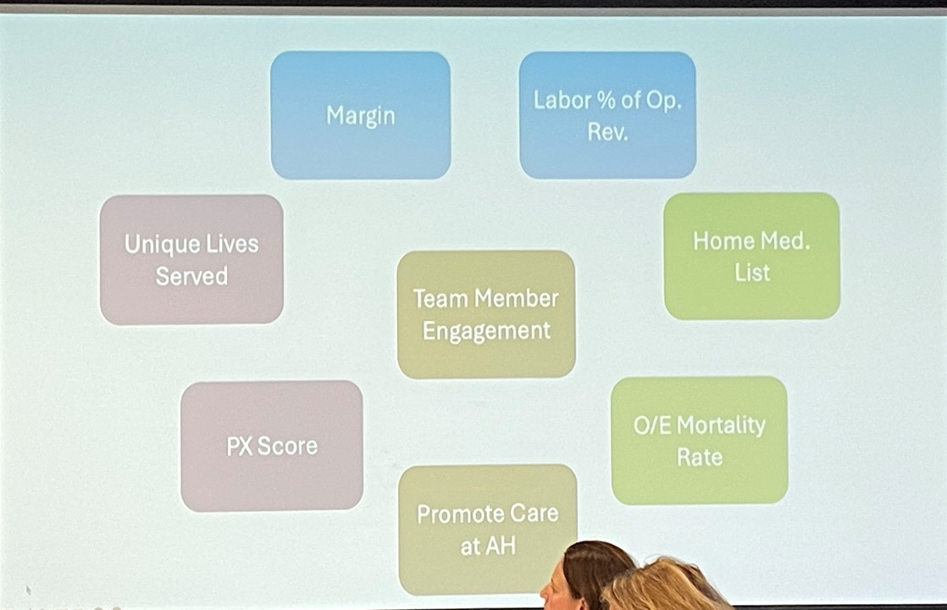

Slide 44
Who Owns
Left Field?

Slide 46
10 Strategies for Fostering a More Positive Culture of Ownership

Slide 47
Strategy 1
Craft a Statement of Cultural Philosophy

Slide 50
From the CHNOLA Statement of Cultural Philosophy
We play so our children can play
We believe in the healing power of laughter, play and fun. We create an environment that encourages curiosity, playfulness, and joy to inspire hope, courage and optimism for our patients and their families. We make a point of smiling at people in corridors, we do our work with joy and enthusiasm, and we set an example of positive optimism for the children and the families we serve.

Slide 51
Strategy 2
Confront toxic emotional negativity

Slide 52
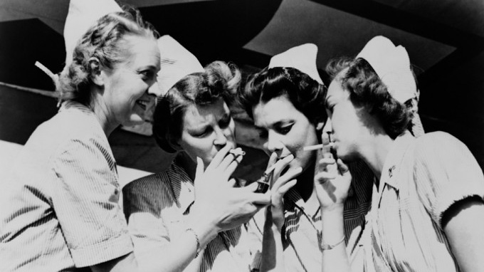

Slide 53
Toxic emotional negativity
is the emotional and spiritual equivalent of cigarette smoke.

Slide 54
The simple promise that will change your life...

Slide 55
And transform your organization...

Slide 58
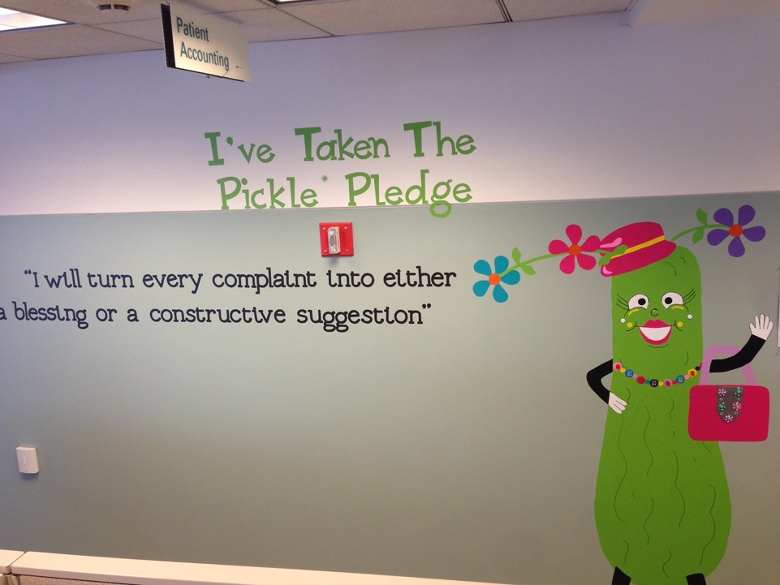

Slide 59
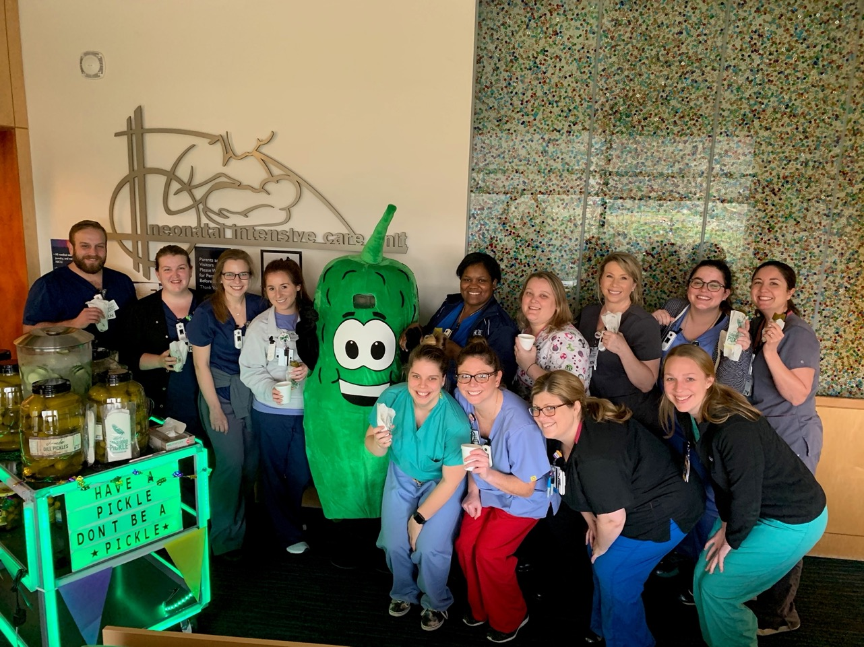

Slide 60
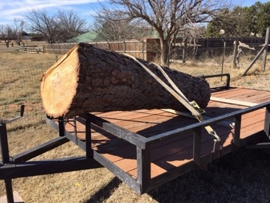
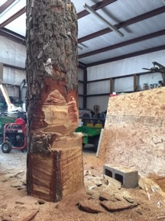
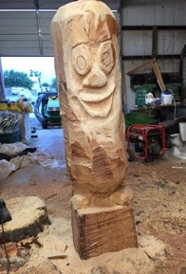
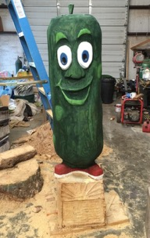
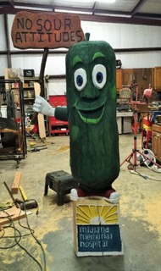
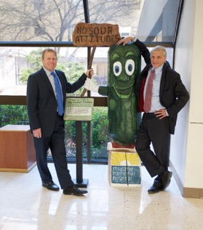

Slide 61
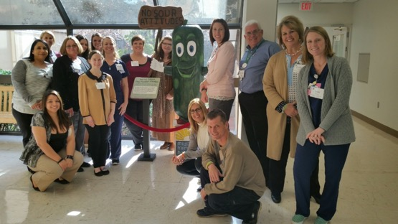
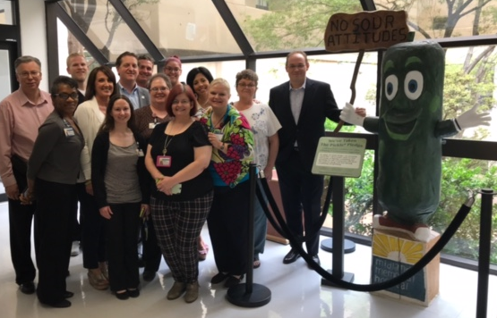

Slide 62
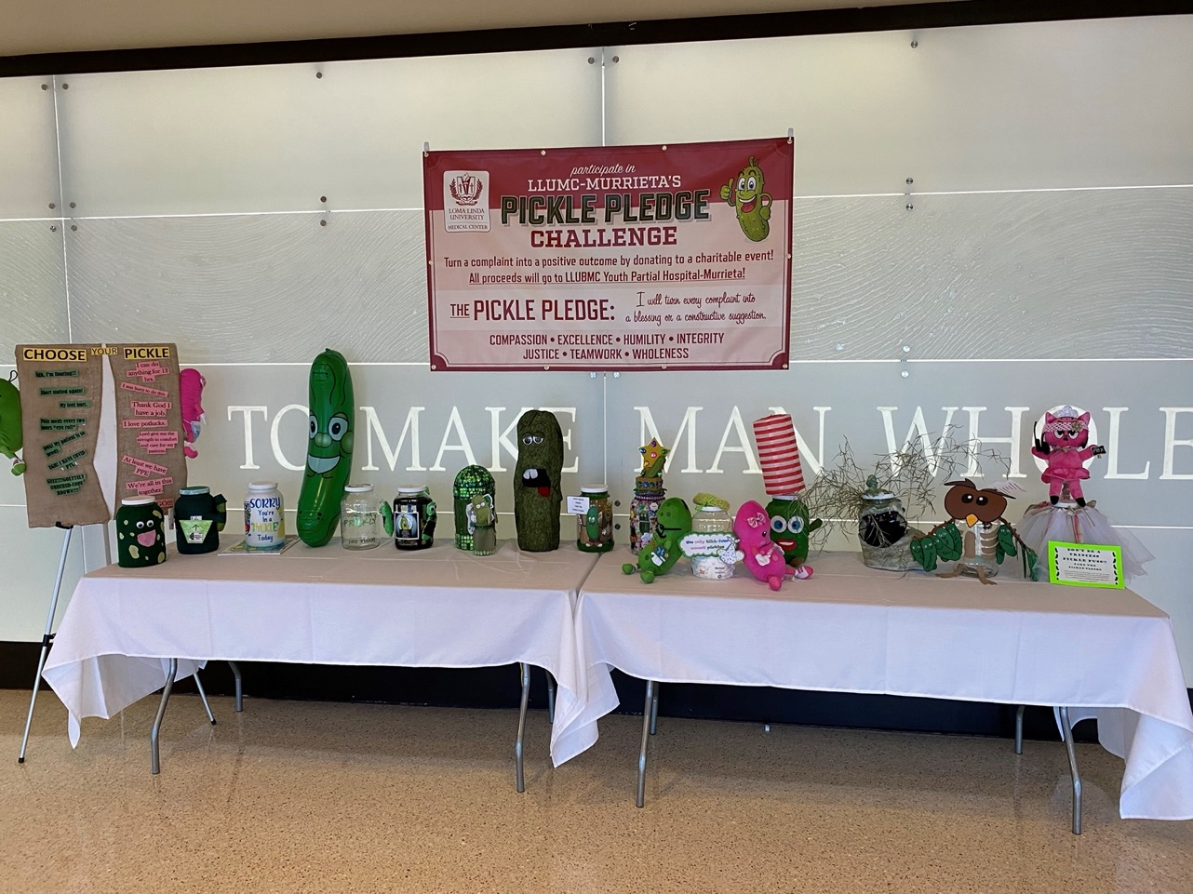

Slide 63
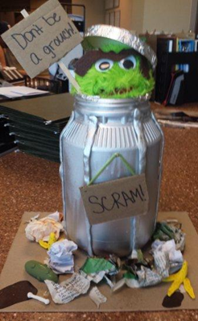
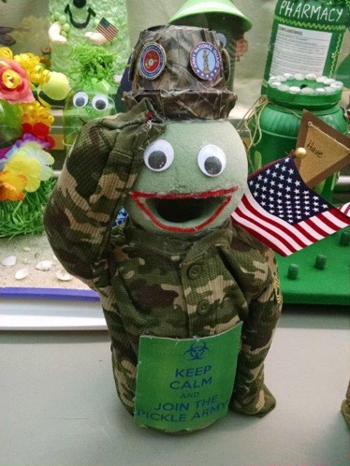

Slide 64
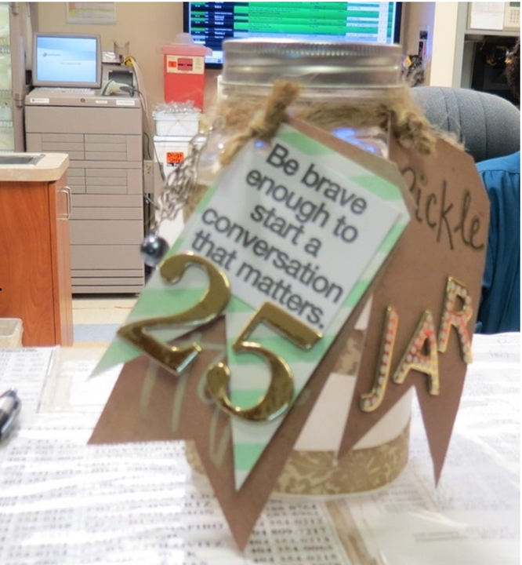

Slide 65
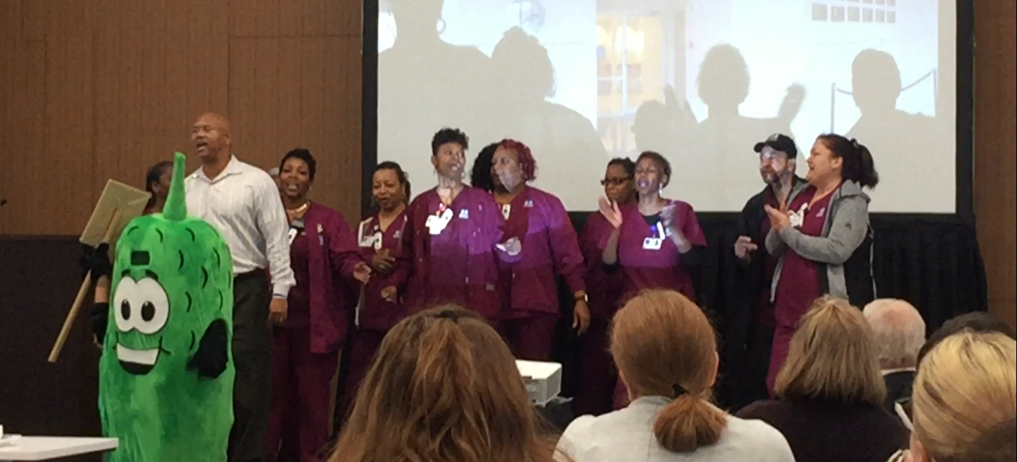
CHNOLA EVS Department “crashes” the monthly leadership meeting

Slide 67
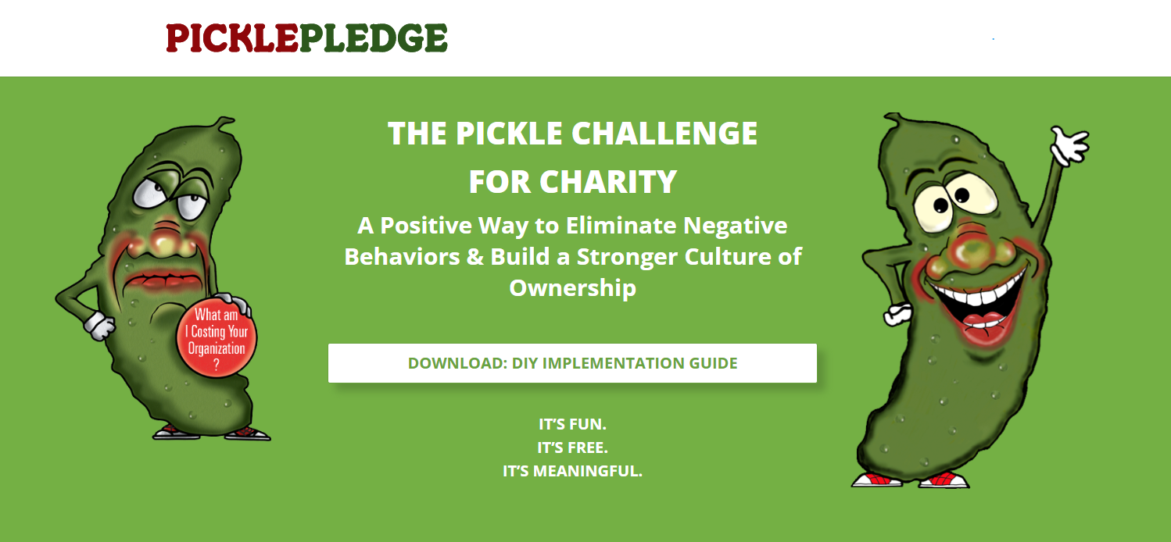
www.PicklePledge.com

Slide 68
Strategy 3
Complement psychological safety with a commitment to emotional safety

Slide 69
Psychological safety is the assurance that people can identify problems and mistakes, including their own, without fear of punishment, retribution, or humiliation.

Slide 70
Psychological safety is about the organization.

Slide 71
Emotional safety is the assurance that leadership is committed to protecting the emotional health
and wellbeing of staff from
internal and external threats...

Slide 72
... and to assuring that care is available for emotional stress or trauma without shame or stigma.

Slide 73
Emotional safety is
about the individual.

Slide 74
Reduce the stigma of asking for help with the Nedlog Rule.

Slide 75
Nedlog is not in the dictionary (yet)

Slide 76
The Nedlog Rule
is the
Golden Rule
in reverse

Slide 77
Whatever you would be willing to do for others if they asked, be willing to ask for the same help when you need it.

Slide 79
Lean on me management!
Notes:
I removed the picture and changed “two” to “three”

Slide 80
Strategy 4
Use rituals to hardwire attitudes and behaviors

Slide 81
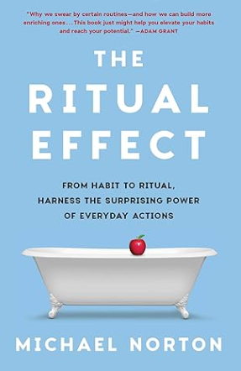
“Rituals are one of humanity’s greatest tools for providing just the right emotional or psychological effect at just the right time.“

Slide 82
Rituals enhance discipline, performance, teamwork, and fellowship.

Slide 84
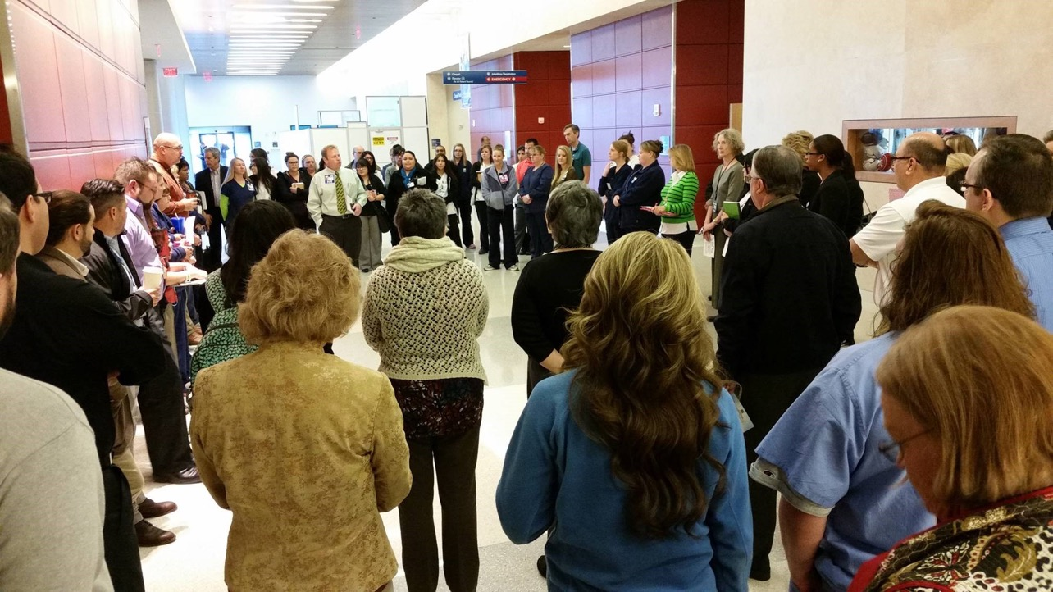

Slide 85
At a personal level, rituals foster courage, endurance, commitment, and joy.

Slide 88
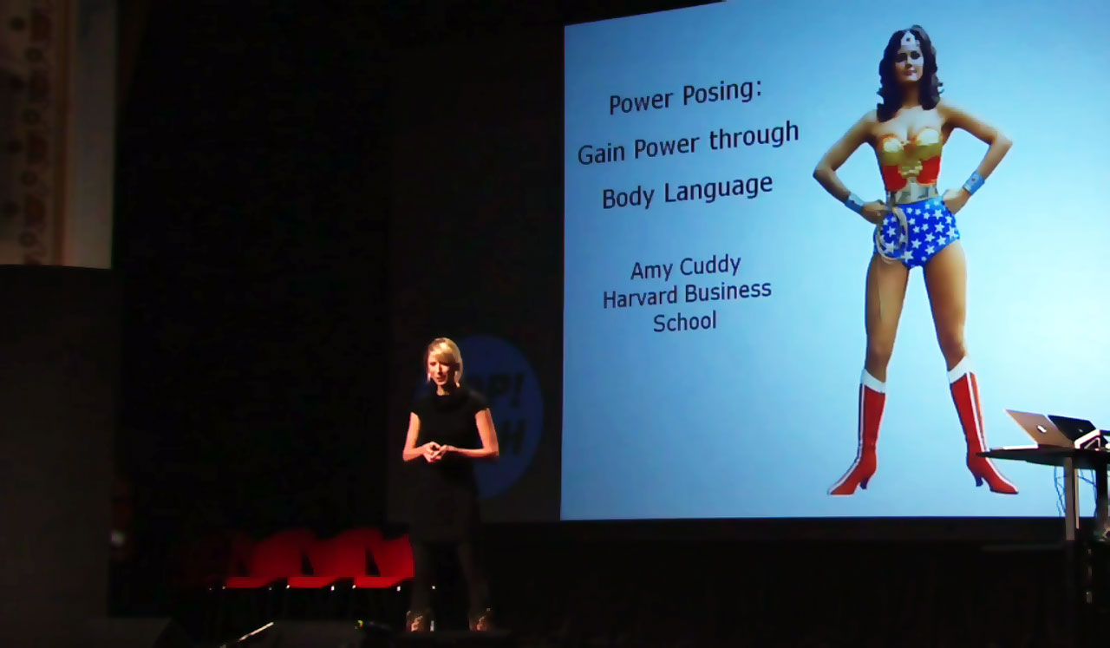
Power Posing

Slide 91
We can use technology
prompts.

Slide 92
Strategy 5
Use stories to shape a shared commitment to cultural expectations

Slide 94
More than 3 million nurses around
the world have been nominated for DAISY Awards and none of them
for having done something they were being held accountable for.

Slide 95
Maddie the Dinosaur Nurse

Slide 96
Maddie did not learn how to care for a triceratops in nursing school

Slide 97
Maddie could not have been held accountable for failing to take care of the triceratops

Slide 98
Maddie took care
of her kiddo’s triceratops because she owned his care

Slide 99
Strategy 6
Promote a Proceed Until Apprehended mindset

Slide 101
If something needs
to be done, do it.

Slide 102
If you need help,
ask for it.

Slide 103
If apprehended,
plea bargain for
a better solution.

Slide 104
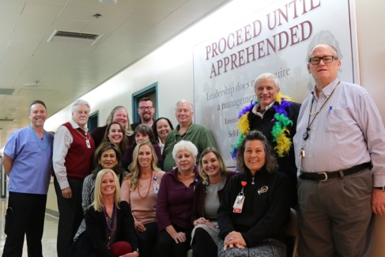
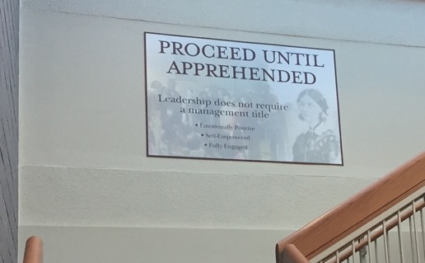
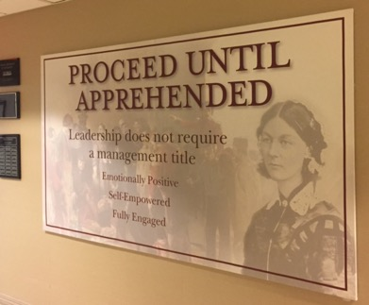
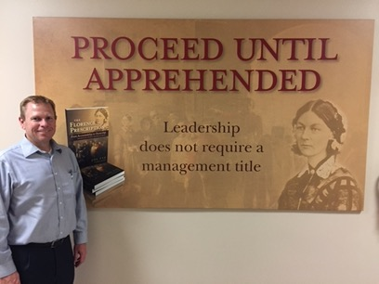
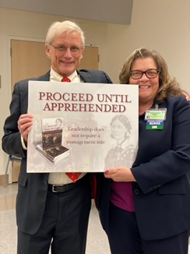

Slide 105
Proceed Until Apprehended
is also an antidote to
learned helplessness and
imposter syndrome.

Slide 107
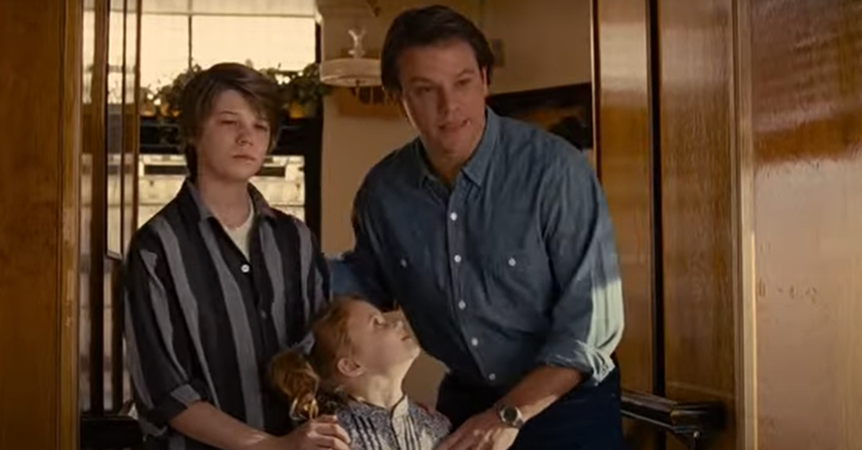
Sometimes all you need is 20 seconds of insane courage.

Slide 108
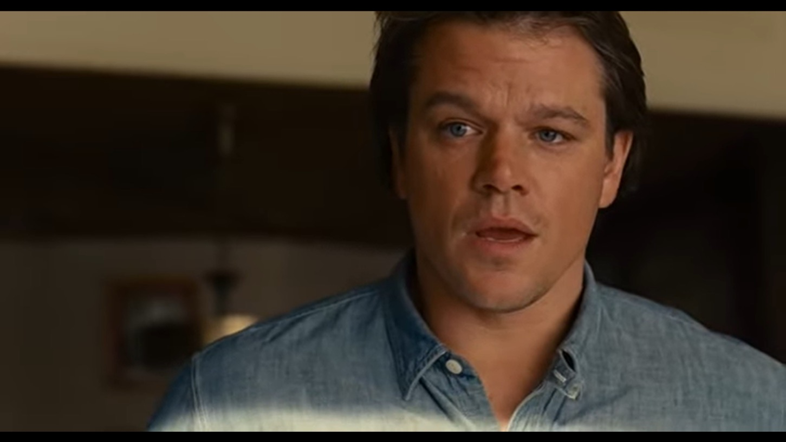
Why would an amazing woman like you even talk to someone like me?

Slide 109
Why not?

Slide 110
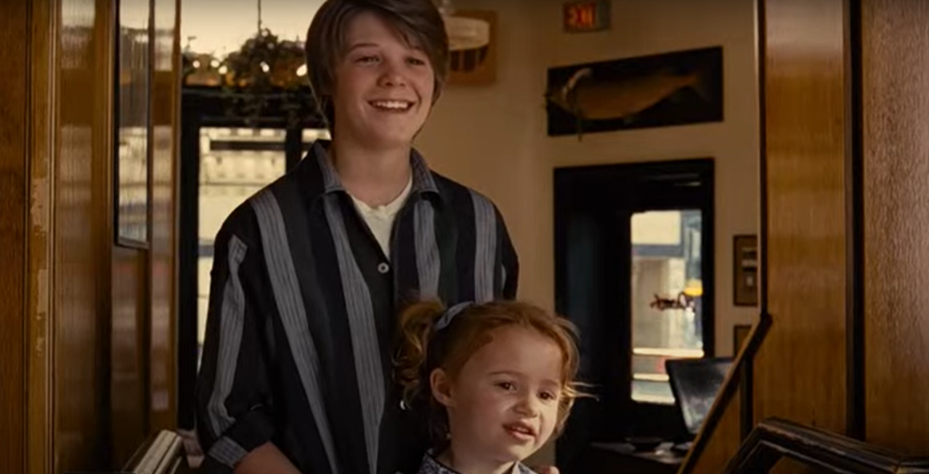

Slide 111
So what is the real insanity?
20 seconds of courage or a lifetime of regret?

Slide 112
Strategy 7
Inspire courage by
linking caring to action

Slide 113
“When [people] are afraid, they cannot hear all the critical things we are telling them.”

Slide 114
Fear is the most serious of all learning disabilities!

Slide 115
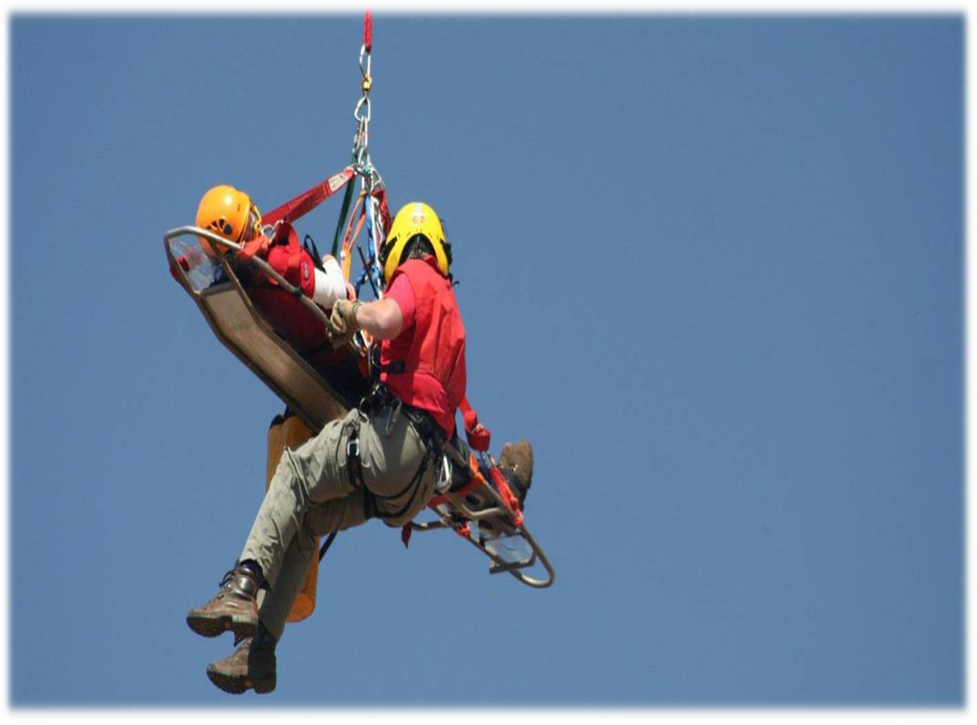
Caring is the root of courage – you wouldn’t be afraid if you didn’t care…

Slide 116
And you act in spite of your fear because you care

Slide 117
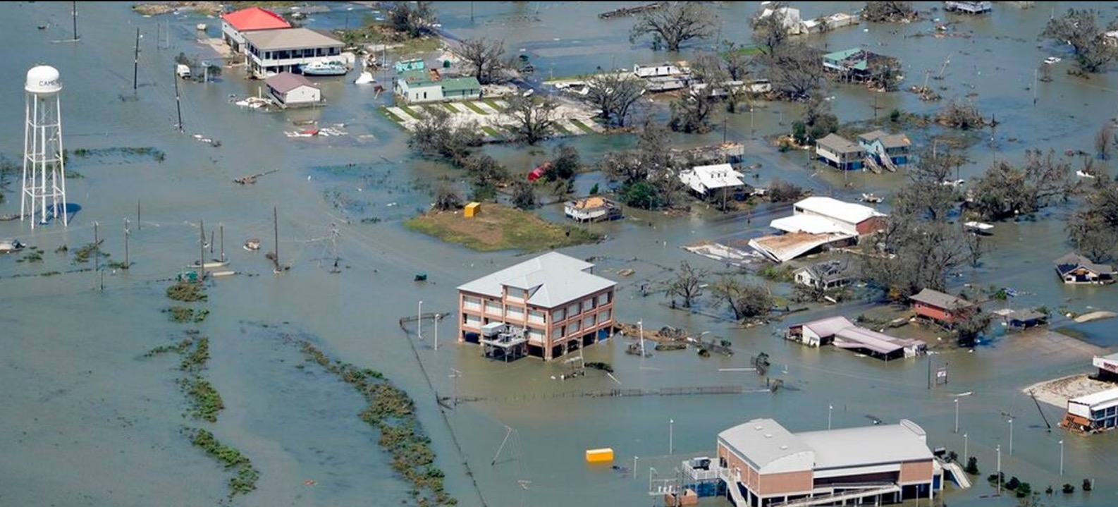

Slide 120
Strategy 8
Spark and fan an extravagant hope

Slide 121
Anyone who would change the world, or a corner of the world, must “spark and fan an extravagant hope.”
Eric Hoffer: The True Believer

Slide 122
Hope is not a strategy

Slide 123
Well duh!

Slide 124
Without hope even the
most brilliant strategy
is doomed to fail.

Slide 125
With hope even a flawed strategy as the potential
to succeed.

Slide 126
The less reason there is
for optimism the more important it is to spark
and fan that hope.

Slide 127
You should have a strategy
for how to spark and fan
extravagant hope.

Slide 128
Strategy 9
Inspire leadership in every corner, not just in the corner office

Slide 131
Leadership
Management

Slide 132
Management is a job description

Slide 133
Leadership is a life decision

Slide 134
Management is what you do

Slide 135
Leadership is who you are

Slide 136
Management expects compliance

Slide 137
Leadership seeks commitment

Slide 138
Management is transactional

Slide 139
Leadership is transformational

Slide 140
Managers start programs

Slide 141
Leaders launch movements

Slide 142
Management will
get you to good

Slide 143
Leadership will
take you to great

Slide 144
Leadership is knowing when the answer is not an answer but a hug

Slide 145
Strategy 10
Create a vision so compelling it becomes a Memory of the Future

Slide 146
Shared vision transforms a stone mason into a builder of cathedrals.

Slide 147
A Memory of the Future is
the difference between
wishful thinking and
positive thinking.

Slide 148
Wishful thinking is hoping
for something and waiting
for someone else to
make it happen.

Slide 149
Positive thinking is expecting something and working to make it happen.

Slide 150
Self-fulfilling prophecy
Hawthorne Effect
Pygmalion Effect
Placebo Effect

Slide 153
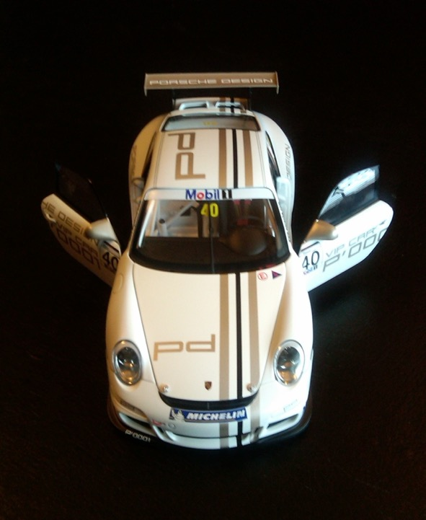

Slide 154
One more thing...

Slide 155
Define your future by your hopes
and not by your fears, by your
dreams and not by your memories.

Slide 156
